Slide 1

ENPM 673: Perception for Autonomous Robots (Spring 2022)
Final project
Optical flow based motion segmentation
Date: 10 May 2022
1. Bharath Irigireddy (UID: 118482804)
2. Saketh Banagiri (UID: 118548814)
3. Balaji Selvakumar (UID: 118545745)
4. Mano Battula (UID: 118546490)

Slide 2
Introduction
The idea behind the project is to perform motion segmentation based on optical flow.
We are using RAFT (Recurrent All-Pairs Field Transforms) to compute optical flow between two consecutive frames.
Of the various motion segmentation techniques, we chose to go with probabilistic approach It’s Moving! Paper by Bideau et al [2]
We are using KITTI MOTS(Multi Object Tracking and Segmentation) dataset since it has video sequences of ground truth for motion segmentation which can be used to evaluate our results.

Slide 3
RAFT : Recurrent All Pairs Field Transforms for Optical Flow
Optical flow is very important and basic question in computer vision, and RAFT really boosts the performance of optical flow to another stage. This can benefit many related area.
RAFT extracts per pixel features, builds multi-scale 4D correlation volumes for all pairs of pixels, and iteratively updates a flow field through a recurrent unit that performs lookups on the correlation volumes
RAFT enjoys the following strengths:
State-of-the-art accuracy
Strong generalization
High efficiency

Slide 4
Components of RAFT
RAFT consists of three main components:
(1) A feature encoder that extracts a feature vector for each pixel.
(2) A correlation layer that produces a 4D correlation volume for all pairs of pixels, with subsequent pooling to produce lower resolution volumes.
(3) A recurrent GRU-based iterative update operator that retrieves values from the correlation volumes and iteratively updates a flow field initialized at zero.

Slide 5
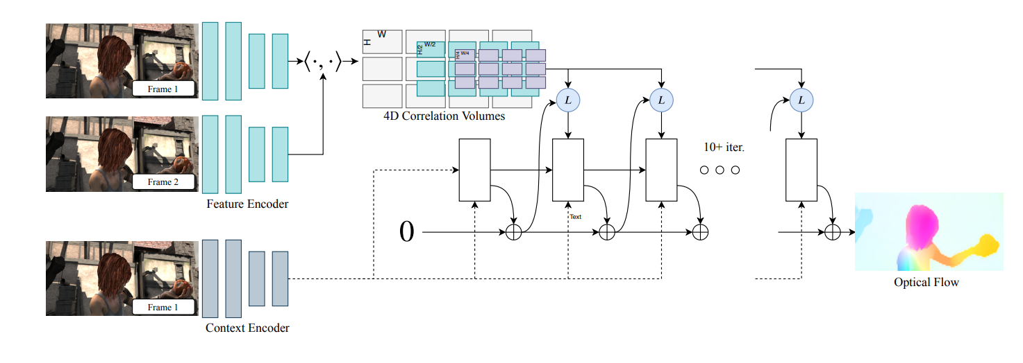

Slide 6
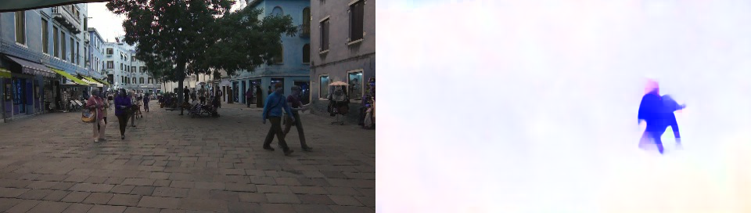
RAFT OUTPUT

Slide 7
Causal motion segmentation
The main drawback of other methods of motion segmentation is that to segment the earlier frame, we must wait for the trajectories which are computed over future frames.
The method we are using currently relies only on the translational flow between two frames and information passed forward from previous frames.

Slide 8
Criteria for motion segmentation
We define motion segmentation in our work as follows:
Every pixel is given one of two labels: static environment or moving objects.
If only part of an object is moving (like a moving person with a stationary foot), the entire object should be segmented.
All freely moving objects (not just one) should be segmented, but nothing else. We do not considered tethered objects such as trees to be freely moving.
Stationary objects are not segmented, even when they moved before or will move in the future. We consider segmentation of previously moving objects to be tracking. Our focus is on segmentation by motion analysis.

Slide 9
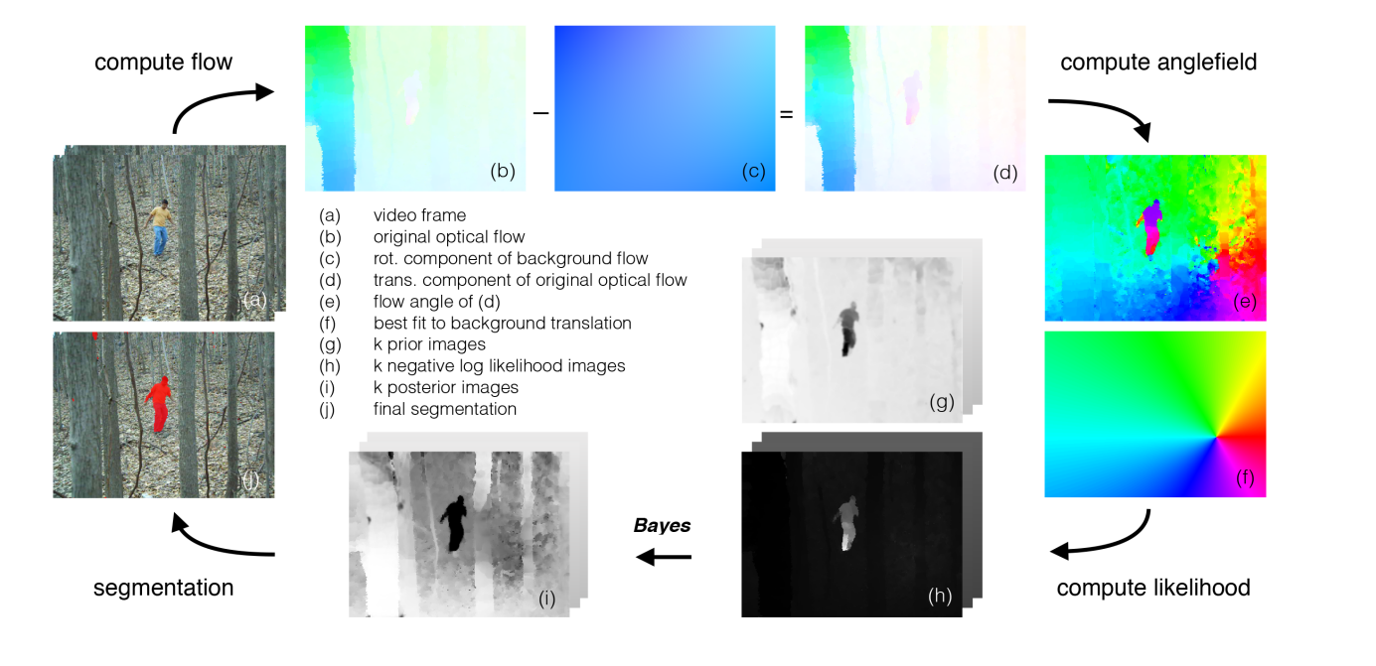

Slide 10
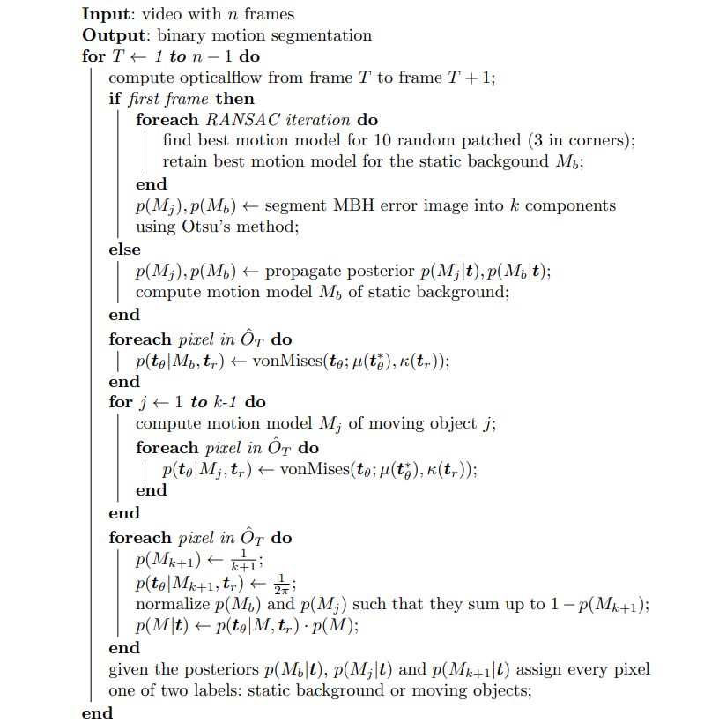
Pseudo code for segmentation process

Slide 11
Estimating and removing rotational flow
We use the prior for the background component to weight pixels for estimating the current frame’s flow due to the camera.
We estimate the rotational (U, V, W) and translational parameters (A, B, C) of the camera using bruss and horns method and then we render the flow angle by subtracting the estimated rotational component (O_{R}) from the Original flow (O) to obtain translational flow (O_{T}).

Slide 12
Flow angle likelihood
Once we obtain translational flow (O_{T}), we use flow vector t to decide which motion component it belongs to.
Since for a given translational motion (wrt camera), the flow angle is completely determined by that motion and the location in the image, whereas the flow magnitude is a function of the object’s depth (which is unknown) Most of the information about the 3D motion direction is contained in the flow angle, not flow magnitude.
However, the amount of information in the flow angle depends upon the flow magnitude. The flow vectors with greater magnitude are much more reliable indicators of true motion direction.
Thus it is critical to formulate the angle likelihood conditioned on the flow magnitude.

Slide 13
Propagating Posterior
From the optical flow obtained by RAFT, we create a prior at each pixel for each motion model in the new frame by propagating the posterior from the previous frame. This can be done in three steps
Use the previous frame’s flow to map posteriors from frame T −1 to new positions in frame T.
Smooth the mapped posterior in the new frame by convolving with a spatial Gaussian. This implements the idea that object locations in future frames are likely to be close to their locations in previous frames.
Renormalize the smoothed posterior from the previous frame to form a proper probability distribution at each pixel location, which acts as the prior on the k motion components for the new frame. Finally, we set aside a probability of 1/(k + 1) for the prior of a new motion component, while rescaling the priors for the pre-existing motions to sum to k/(k + 1).

Slide 14
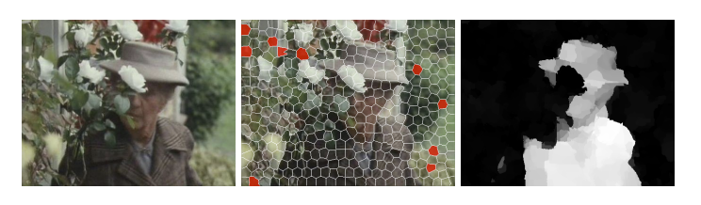
Initialization: Segmentation of First Frame
The goals of the initialization are:
1. estimating background translation and rotation parameters.
2. finding pixels whose flow is consistent with this motion model.
3. assigning inconsistent groups of contiguous pixels to additional motion models.
We use a constrained RANSAC method to estimate the background motion.
We use 10 random SLIC superpixels to estimate camera motion. We modify the standard RANSAC procedure to force the algorithm to choose three of the 10 patches from the image corners, because image corners are prone to errors due to a misestimated camera rotation.

Slide 15
Video collection
We used a robot consisting of Picam, Rasberry pi to collect the data for our project.

Slide 16
Results
The whole segmentation process (getting optical flow from RAFT to segmenting it in MATLAB) takes a lot of time to complete. So videos of short duration are used.
Video quality from Pi Camera is low, so optical flow output from RAFT was poor. This effects the motion segmentation output.
Results can be found in results folder and in drive link

Slide 17
References
Zachary Teed, Jia Deng ,RAFT: Recurrent All-Pairs Field Transforms for Optical Flow Computer Vision – ECCV 2020
Bideau P, Learned-Miller E. It’s moving! A probabilistic model for causal motion segmentation in moving camera videos. European Conference on Computer Vision, Amsterdam, Netherlands; 2016. p. 433–449.
Shivangi Anthwal & Dinesh Ganotra (2019) An overview of optical flow- based approaches for motion segmentation, The Imaging Science Journal, 67:5, 284-294,
Brox, T., Malik, J.: Object segmentation by long term analysis of point trajectories.In: ECCV. (2010)
Tron, R., Vidal, R.: A benchmark for the comparison of 3-d motion segmentation algorithms. In: CVPR. (2007)
Narayana, M., Hanson, A., Learned-Miller, E.: Coherent motion segmentation in moving camera videos using optical flow orientations. In: ICCV. (2013)
Grundmann, M., Kwatra, V., Han, M., Essa, I.: Efficient hierarchical graph-based video segmentation. In: Computer Vision and Pattern Recognition (CVPR), 2010 IEEE Conference on, IEEE (2010) 2141–2148
Bruss, Anna & Horn, Berthold. (1982). Passive Navigation. Computer Vision, Graphics, and Image Processing. 21. 3-20. 10.1016/S0734-189X(83)80026-7.

Slide 18
Thank you

